Slide 1

OVERVIEW FOR TECHNOLOGY PARTNERS
SHARED UNDER NON-DISCLOSURE AGREEMENT
Apr 2016
Sagun Saxena, Chief Technology Officer
©2014 SmartCook Energy Limited | Proprietary & Confidential

Slide 2
Venture Overview
Technology Development Program Overview

Slide 3
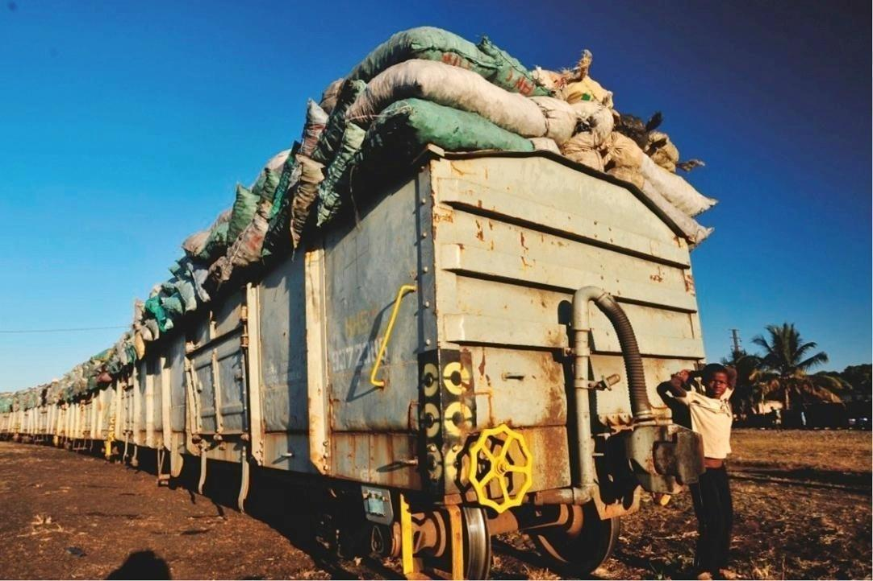
Charcoal is urban Africa’s primary cooking fuel
BIG MARKET
$30/month per urban family
30+ million homes in 40 African cities
= $12 billion annually
BIG IMPACT
5 million acres of forest loss
1 billion tons of CO2e
600,000 deaths
…annually

Slide 4
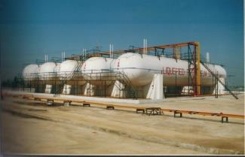
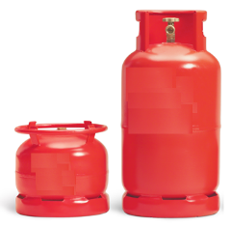

URBAN AFRICAN COOKING FUEL MARKET IS RIPE FOR DISRUPTION
Challenges for LPG Cooking Gas
Expensive Infrastructure
Poor mass-market safety brand
Can’t mainstream without subsidy
COOKING FUEL MARKET IN AFRICAN CITIES
LPG $3 B.
CHARCOAL $12 Billion
Challenges for Kerosene
Terrible smell
Fuel of last resort when trees run out
Pressurized stoves -> slum fires
KEROSENE $5 Billion

Slide 5

Urban Africa Is developing rapidly
I am an urban African:
I watch new movies at home
I love Whatsapp and Facebook
I pay with M-PESA
I hate charcoal because:
It takes too long to light
It’s dirties my clothes & hair
The price keeps rising

Slide 6
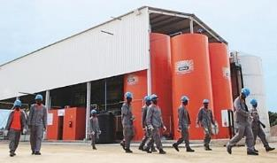


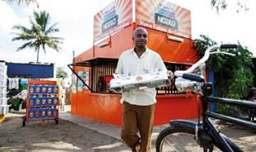





Our pilot ethanol-based cooking solution captured 10% of Maputo households within first year of launch (Maputo –capital of Mozambique– has ~2m residents living in ~400,000 households)
KEY LEARNINGS FROM NDZiLO PILOT
CUSTOMERS LOVE THIS NEW WAY OF COOKING (even at $6.25 / gallon = price parity with charcoal on monthly spend basis)
WITH LOWER PRICES, ETHANOL-BASED COOKING CAN BE MASS-MARKET (50%+)
SMARTER TECHNOLOGIES & BUSINESS MODEL REQUIRED TO CAPTURE MARKET
Eliminate bottling & packaging
Eliminate middlemen
Eliminate cash handling
Reduce upfront cost of stove
Increase fuel availability
Direct customer relationship

Slide 7

INTRODUCING KOKO NETWORKS
A smart local commerce platform that enables urban Africans to conveniently access innovative consumer products & services … starting with modern cooking fuel

Slide 8
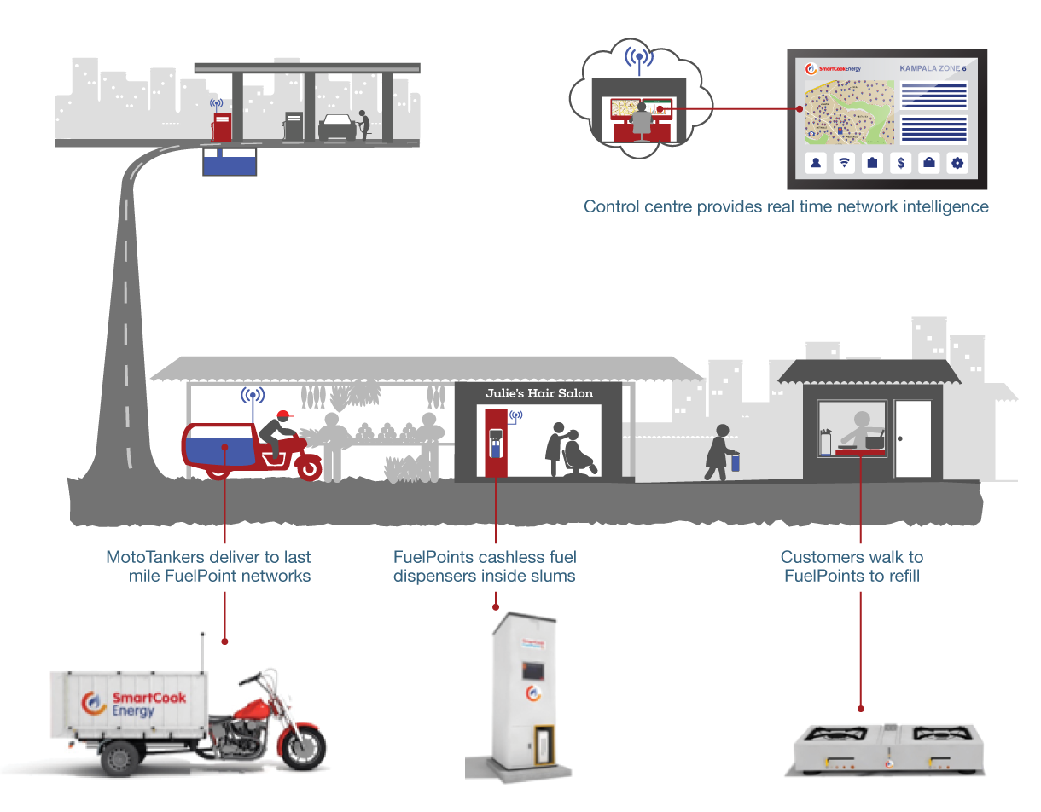




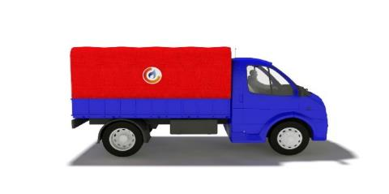
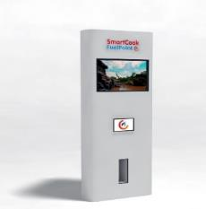
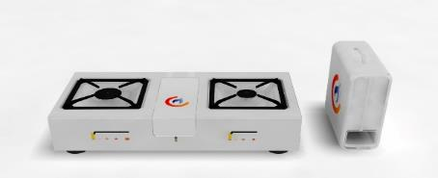
Key Technology & Business Model Innovations
Fuel Depot
fuel stored within petrol stations
Control Room visibility & control across entire network
MicroTanker efficient last-mile delivery
FuelPoint network self-serve dispenser within 150m of customer
Stove & Canister
affordable modern cooking solution
Fuel Wholesaler owns fuel
Shopkeeper owns fuel
Customer owns fuel

Slide 9
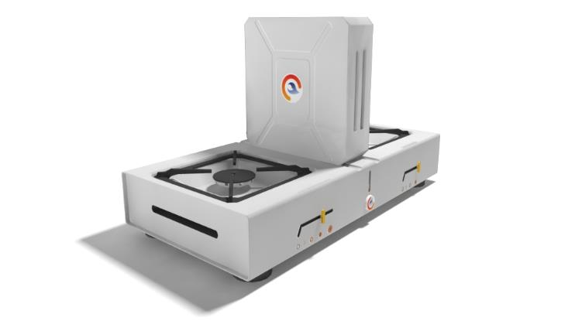

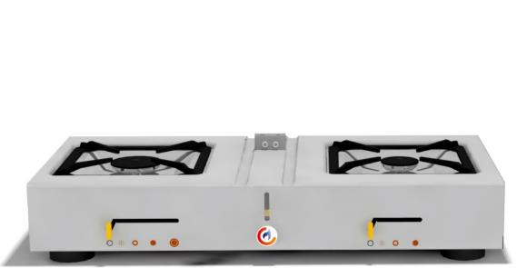


SMARTCOOK STOVE
Offering under SmartCook brand: + SmartStove :2-burner ethanol stove + SmartCanister: reusable fuel container + Pre-paid KOKO account
KEY BENEFITS
TECHNICAL FEATURES
FAST – saves customers time lighting charcoal
AFFORDABLE – financing available on stove – reduction in fuel costs
CLEAN – no fuel handling, no smoke, no soot
CONVENIENT – Fuel available within 150m
EFFICIENT – 3-4 X efficiency of charcoal stoves
SAFE – no vapor, CO or PM emissions – tipping causes auto shut off
PROPRIETARY FUEL ONLY – SmartValve connects stove & canister – Canister contains NFC chip to ID customer

Slide 10
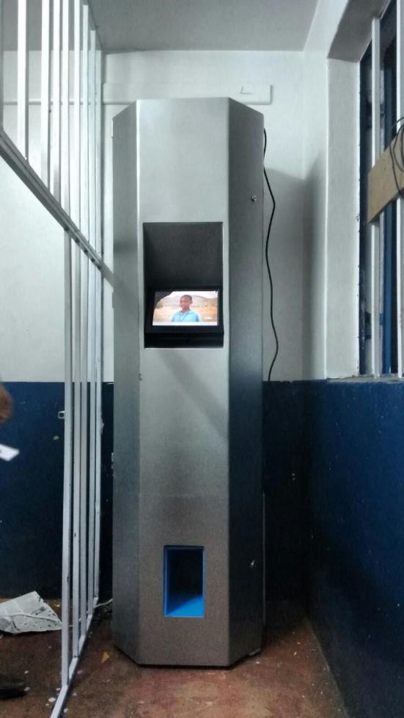
KOKO POINT
KEY BENEFITS
EFFICIENT – eliminates packaging costs and intermediary margins
CONNECTED – to range of KOKO cloud services
PLATFORM – video advertising, news, entertainment
TECHNICAL FEATURES
SAFE – stores and dispenses with no vapor release – engineered for lock-down in case of valve failure, tampering/shaking, or local fire
AUTOMATED – customer self-serve – gravity-fed from 200L tank
ROBUST – 100% uptime, backup battery

Slide 11
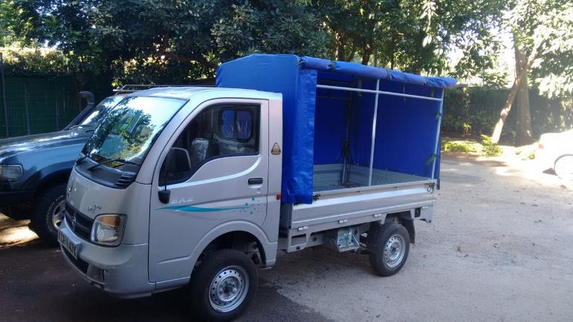
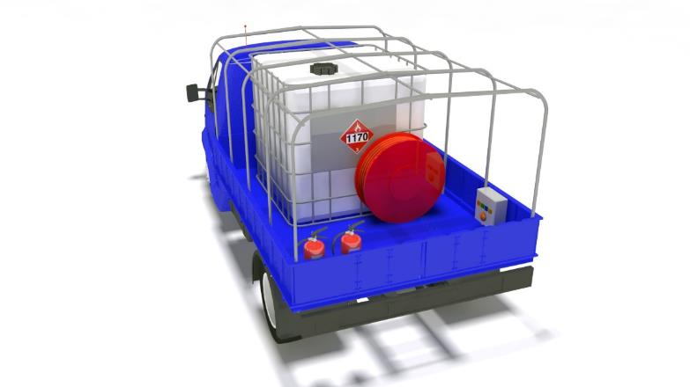
MICRO TANKERS CARRY FUEL FROM PETROL STATION TO FUELPOINT
KEY BENEFITS
TECHNICAL FEATURES
SAFE – international standards, bulk fuel
VERSATILE – narrow streets, potholes and slopes
CONNECTED – driver dynamically guided on route
FAMILIAR BASE VEHICLE – popular last-mile slum workhorse – easy to maintain
ROBUST – 1,000L payload – rugged equipment
SIMPLE – strong pump with long hose – intuitive and safe for semi-skilled users
CONNECTED – visibility on tanker fuel level, transaction history and location at all times

Slide 12
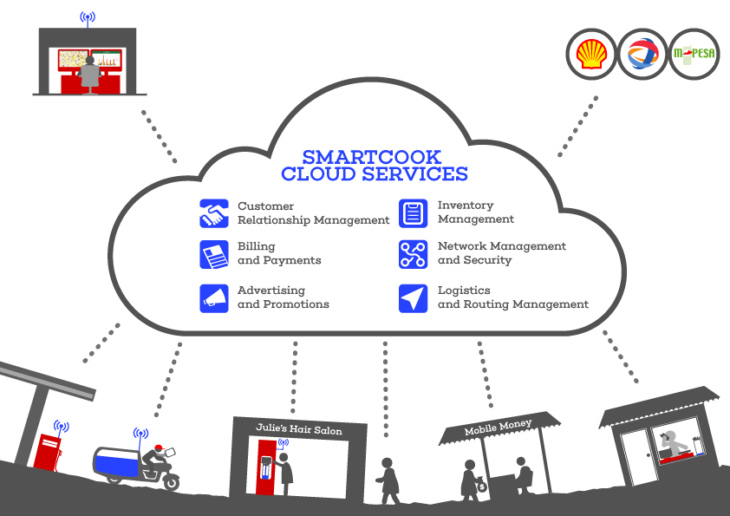

CLOUD SERVICES ARE CRITICAL TO EFFICIENT NETWORK MANAGEMENT

Slide 13
IMPACT OF THESE TECHNOLOGY & BUSINESS INNOVATIONS:
OVER 30% DISTRUBTION COST ELIMINATION (vs CENTRALISED BOTTLING)
→ STRONG SAVINGS FOR CUSTOMERS → STRONG MARGINS FOR FUEL VALUE CHAIN
HOUSEHOLD BUDGETS
CONSUMER EXPERIENCE
REDUCTION IN FUEL BILL & TIME SPENT
STOVE FINANCE AVAILABLE
FUEL AVAILABLE IN SMALL INCREMENTS
CONVENIENT / FAST
ACCESSIBLE WITHIN 150M OF HOME
CLEAN, SAFE, MODERN
DEMAND FORECAST:
APPROX 50% OF HOUSEHOLDS WILL SIGN UP WITHIN 18 MONTHS OF LAUNCH

Slide 14


FUEL IS KOKO’s TROJAN HORSE: THE PRODUCT THAT PAYS FOR THE NETWORK
When We Have:
~ 50% of households in every city
Visiting 2-5 times per week
Registered in our systems
1000’s of Kiosks with fast cheap data network
Private TV broadcast network
2-way rich media interface
We Are A Hub For Digital Services
Advertising
Financial services
Wi-Fi hotspots…
Rich digital media distribution…
Information access (health, education)…
E-commerce gateway…

Slide 15
KOKO REVENUE SOURCES
Fees from Agents who want KOKOpoints installed exclusively in their shops
~$2000/agent , estimate approx. 2000 agents in Nairobi
Margin on Fuel sales through each KOKOpoint
10% of Retail Fuel Sales → ~$2 to $3 per customer per month
→ ~$400 to $600 per KOKO Point per month
3) Advertising revenue from placing 3rd party ads on KOKO screens
~ $1 to $2 per customer per month
4) Commission/margin on durables ordered via KOKO network
Initially, on the SmartStoves & Canisters produced by our contract manufacturers
Later, on products supplied by distributors, e.g. Pressure cookers, crockery, etc.
5) Long term (in expansion cities): Fees from licensing full KOKO tech suite & system to partners that want to set up and run local KOKO network themselves
TBD – mix of upfront + ongoing throughput-linked
Unlike NDZiLO, KOKO never actually owns fuel

Slide 16





Our team in Nairobi & Kampala
Richard Taylor, Chairman*
Greg Murray, Chief Executive Officer*
35 years in energy industry globally
Chairman BP Brazil, led $1B ethanol investment
Serial Entrepreneur
18 years experience
Africa, Arabia, Brazil, Asia, Australia
Sagun Saxena, Chief Technology Officer*
Micael da Costa, Chief Systems Architect
Technologist & Serial Entrepreneur
20 years experience
Berkeley Engineer & Oxford MBA
Engineer / Developer
Defence Industry, Telecoms, Startups
MSc Energy (Imperial), BEng Electronics (Bristol)
Nick Stokes, Chief Financial Officer
10 years PE & investment banking
AEA Investors, Govt of Singapore Investment Corp, Citibank
*Board of Directors

Slide 17







Our team in Nairobi & Kampala
STAFF
CONTRACTORS
John Woolsey
Project Management
Global media, tech and comms analyst at boutique consultancy. Experience in tech venture incubation in Kenya. B.S. Engineering (Michigan)
Thies Timmermans
Product Design
SmartValve & Canister design, prototyping
Mehul Shah
Mech Eng
Stove design, prototyping & testing
Payan Ole-MoiYoi
Mech Eng
Metal design & prototyping fabrication
Theresa Karungi
Product Manager - SmartCook
Formerly co-Founder & Lead Project Manager, Kola Studios. Google Uganda. Bachelor Computer Engineering (Makerere)
Barre Yassin
Product Design
FuelPoint and Canister design
Peter Mwako
Mech Eng
Prototyping fabrication
Seb Kilimo
Product Manager - Financial Svcs
Formerly Project Manager at KOPO KOPO; rich experience with East African consumer & SME financing technology sector
Wilson Muirani
Product Manager – Advertising Svcs
Formerly account manager at Squad Digital; Advertising experience in leading East African agency and media house; Founded and sold WhatHappeningKenya website
Gert Maas
Product Design
Tilt valve design & China mfg
Michael Wanyera
Market Dev Advisor
Former head of retailing for Total (Uganda)
10 years experience in oil & gas retailing in East Africa
PARTNERS
Red Panda Ltd. Software Dev Partner
Bespoke mobile and cloud-based information systems developer with experience building mission-critical applications for fast-growing tech companies in emerging markets
Angelo Obel
Senior Systems Engineer
All-around systems design & development experience in various high impact projects in East Africa
GearBox Nairobi
Prototyping facility

Slide 18
Venture Overview
Technology Development Program Overview

Slide 19
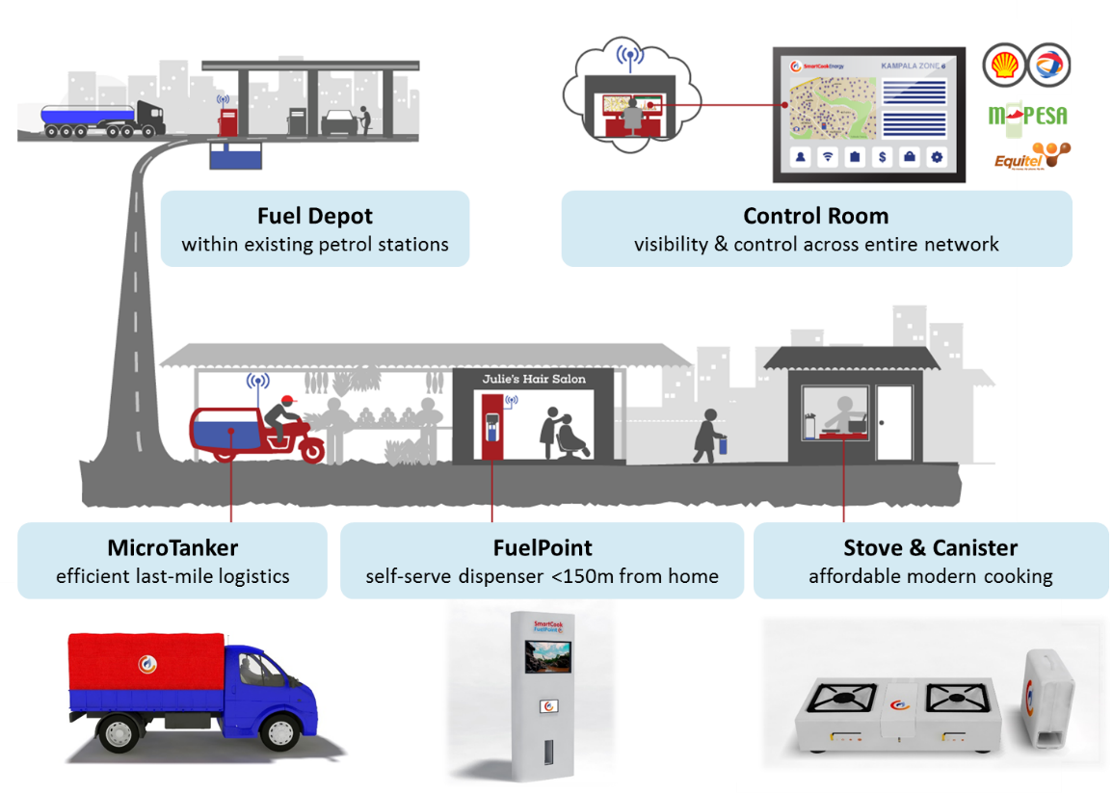
SmartCook Technologies
The Scalability, Profitability, & Impact of KOKO Networks Depends on its Technologies
Visibility | Control | Operational Efficiency
Market Intelligence | Technology Licensing Partnerships Regulatory Compliance | Risk Management

Slide 20

Enabling Trends
Key Enabling Tech Trends for SmartCook
Urban mobile phone revolution
Universal mobile phone ownership
Reliable 3G mobile coverage through cities
Growing use of Mobile Money for payments
Electricity (UMEME Yaka), Water, School Fees, e-Gov
Closer / 1:1 customer relationship via SMS, Facebook, etc.
More powerful and affordable electronics, sensors, connectivity, computing power & data storage
“Internet of things”
“Cloud services”
Development of local manufacturing, assembly & support environment in East Africa

Slide 21






Design Principles
KOKO Technologies Must Cater for Many Different Users
End Users
Fuel Point Hosts
Operations Managers
Tanker Drivers
Depot Managers
Local Partners /
Licensees

Slide 22
Design Principles
Guiding Design Principles for SmartCook
Safety
1
Cost / Affordability
2
Of Customers, Partners, Employees, Public at large
Compliance with international fuel safety standards (UK, South Africa, US) where none exist locally
For Consumers
Upfront cost
Ongoing usage cost
Production & maintenance costs
3
Reliability
Context-sensitivity
4
Predictable performance
Easy serviceability
User-centric design:
Fit with local culture, traditions, norms, trends
Local manufacturing opportunities & challenges

Slide 23
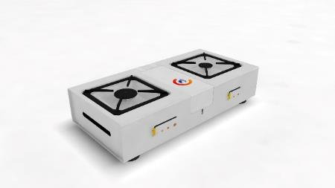

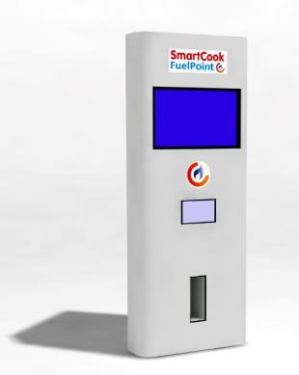

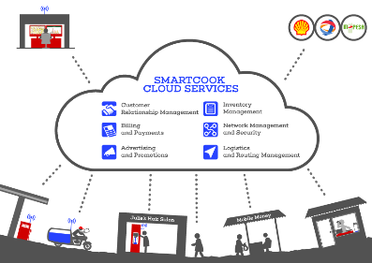
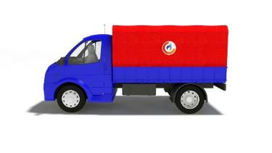
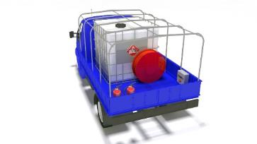
INTRODUCING SMARTCOOK
SmartCook Suite under development
Smart Ethanol stove & fuel canister with significant advantages over current systems, offered for low upfront cost with financing
Automated canister refilling points placed in 800-1,000 shops throughout the city, creating income for small businesses/entrepreneurs
Software and mobile technology that enables local operators of this system to track inventory,
cashless payments, and impact information
Fuel microTanker that can safely and efficiently carry fuel to Fuel Points located deep inside low-income neighborhoods/settlements

Slide 24






INTRODUCING SMARTCOOK
Underlying technologies, materials & production processes
Metals (sheet metal stamping, forming, joining, finishing)
Plastics (injection & blow molding, vacuum forming)
Electronics (PCB design, fabrication, assembly, testing)
Software (analysis, design, UX, cloud & app dev, data & network mgmt, support)
Testing & Standards certification (materials, performance)

Slide 25
Roadmap
We’re following an iterative, field-based approach to Tech Development
Research Ideate
v.1
Build
Measure
Learn
Launch (Feb ‘15)
(Minimum viable product & micro pilot scale)
v.2
Build
Measure
Learn
Launch (Jun ‘15)
(“alpha” @ Pilot scale)
v.3
Build
Measure
Learn
Launch (Oct ‘15)
(“beta”@ Demo scale)
v. n
Build
Measure
Learn
Launch (Jan ’16, Apr ’16, Oct ‘16)

Slide 26
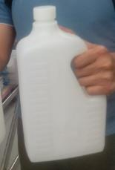

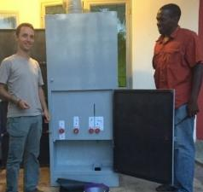
Roadmap
v1 was rolled out in Feb 2015 in Kampala
2
Stove:
Dometic stove (unmodified)
FuelPoint:
Manually controlled fuel dispenser prototype
Key Resources:
SmartCook team (3)
Contract metal fabricator
Piping contractor
Canister:
Reusable plastic container
Transport:
Jerry can
Enterprise Software:
Paper-based
Test User Group:
12 houses in Kintintale, Kampala
Key Learnings:
Local users have virtually identical issues with Dometic stove as Maputo market
FuelPoint-based fuel distribution accepted by users; no demand for other options
FuelPoint v1 technical concept works well; but slow to operate; bulky
FuelPoint refilling should be done from outside salon if possible

Slide 27
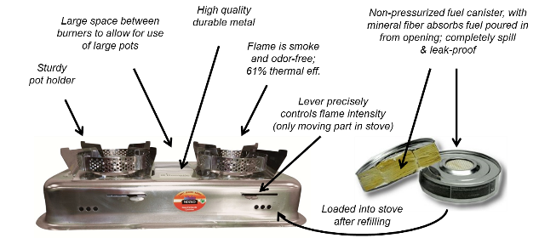
Roadmap
v1 was rolled out in Feb 2015 in Kampala
2
In v.1 we used Dometic CleanCook Stove (Durban edition) as sold in Maputo:

Slide 28
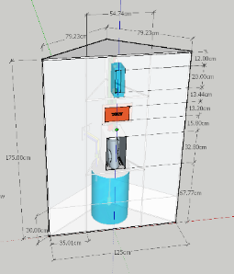
Roadmap
v2 was rolled out in June 2015 in Kampala
2
Stove:
Dometic stove (unmodified)
SAFI stove (unmodified)
FuelPoint:
Automated controls
Graphical interface
Sensor alarms
Outdoor refueling
Key Resources:
SmartCook team (5)
Contract metal fabricator
Piping contractor
Canister:
Reusable plastic container with SmartChip
Transport:
MotoTanker with manual power pump + air & fuel hoses
Enterprise Software:
Google-based reporting from Automated FuelPoint
Test User Group :
15 houses in Kintintale, Kampala
Key Learnings:
SAFI is preferred over Dometic, but users concerned about power, safety, durability
NFC-based identification works well; simplifies & accelerates dispense process
Flow-meter and electronic sensors/controls allow excellent precision & tracking
External refilling works ; FP footprint can shrink; FP can be a media display

Slide 29
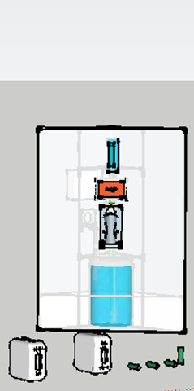
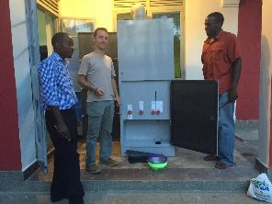
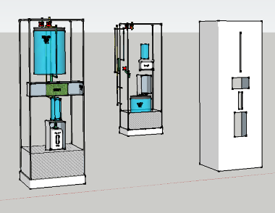
v2: We considered several design directions, eventually settling on a “corner-fitted” design with electronic fuel pump & metering
Version 1.0 (Feb 2015)
Version 2.0 final design
Version 2.0 concepts

Slide 30

Development Roadmap
v2: Goals
Goals Set for FuelPoint v.2 (FPv2):
Smaller footprint
Auto user recognition (NFC)
Graphical user interface
Automated valve controls
Backup power system
Sensors & alarms
Outdoor refueling & venting
Goals for MicroTanker v.2:
Tank fitted for safety, stability and handling
Electric pumping to FP
Three lines for: Fuel out, Fuel in, and Tank Vent
“Quick-Connect” hoses

Slide 31
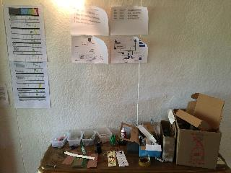
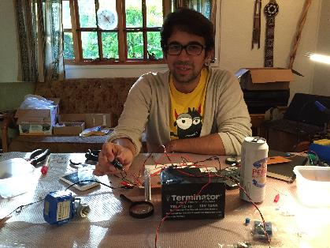
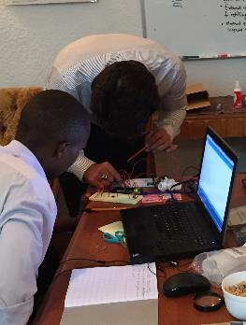
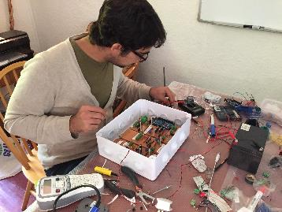
v2: Design, Development, Testing of Embedded Systems

Slide 32
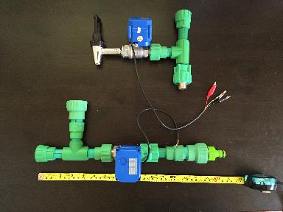
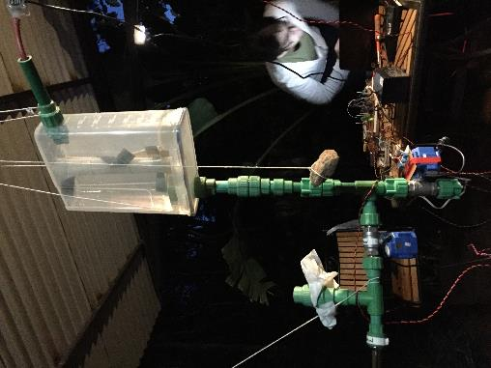
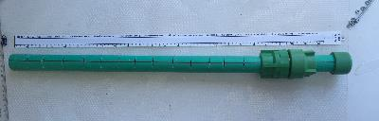
v2: Design, Dev, Testing of Piping, Valves & Level Sensors

Slide 33
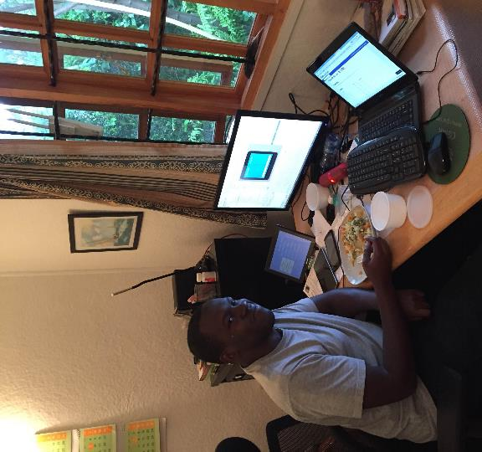
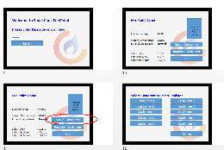
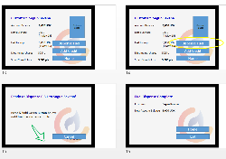
v2: Design, Development & Testing of Graphical User Interface & Android Tablet Application

Slide 34
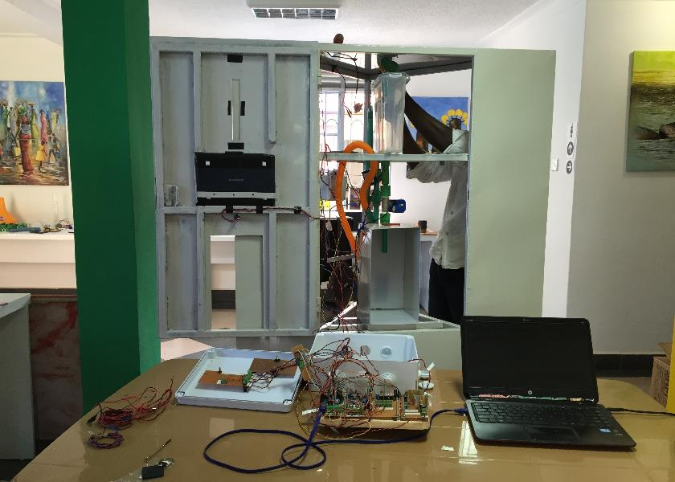
v2: Integration & Testing @ VentureLabs, Kampala – 13 May 2015

Slide 35
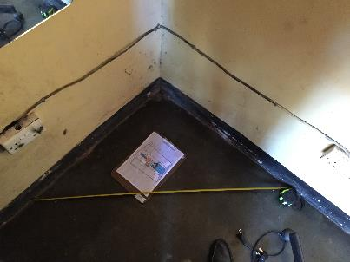
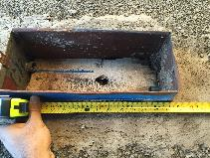
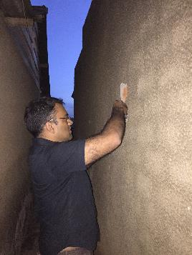
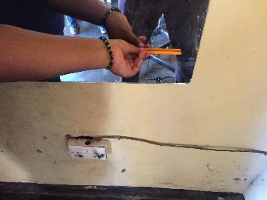
v2: Preparation of Mary’s Salon in Kitintale, Kampala – 13 May

Slide 36
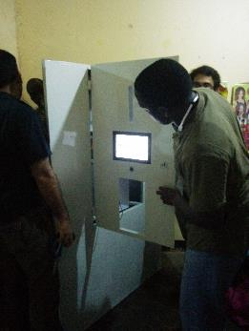
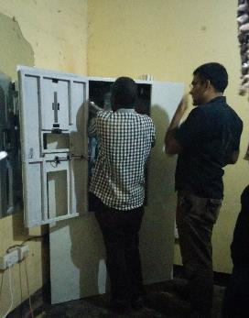
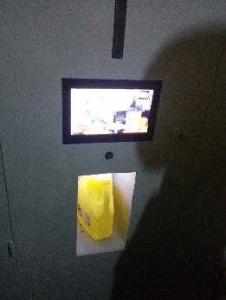
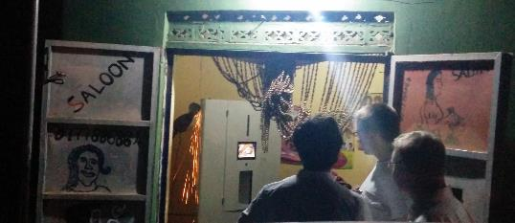

v2: Installation & Connection to Outdoor Vent & Refill Points

Slide 37
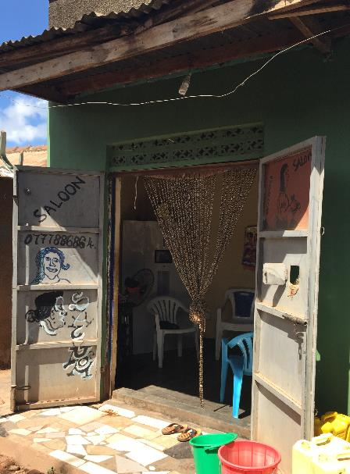
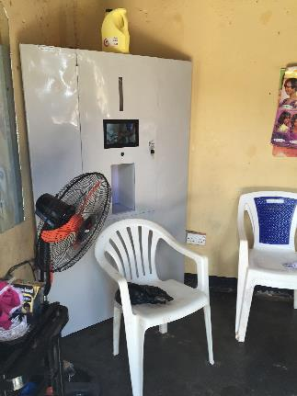
v2: Training & Commissioning

Slide 38
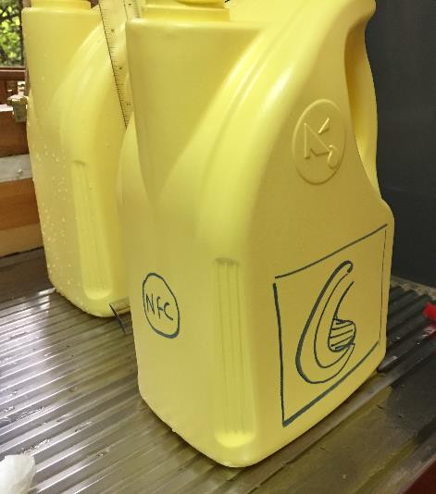


v2: Fuel Canister: Design, Dev, Testing of various Fuel Canisters formats & NFC chip placement

Slide 39
v2: achievements vs. goals
Achievements with FuelPoint v.2:
Smaller footprint (30% less space, feels much less obtrusive)
Auto user recognition (successfully implemented via NFC)
Graphical user interface (custom app built for 10” Android tablet)
Automated valve controls (Arduino + motorized valves)
Backup power system (12V battery, recharged from mains socket)
Sensors & alarms (flow, fuel level, temp, Et0H vapor sensors)
Outdoor refueling & venting (lockbox outside can be accessed anytime)
(Plus, we were able to implement basic cloud connectivity; enabling us to track fuel level, transaction activity & sensor readings over the Internet)
Achievements with MicroTanker v.2:
Tank fitted for safety, stability and handling (Done, 70L capacity)
Electric pump (Done, 7L/min max)
Three lines for: Fuel out, Fuel in, and venting (Done)
Quick connect hosing (Done)

Slide 40



ACTIVITIES
v3: FuelPoint Development Objectives & Activities
3
Further streamlining footprint
Reworking electronic systems: moving away from Android + Arduino for more robustness, power, capability
Built custom PCB to streamline electronics backbone, while retaining flexibility
Provisioning 2nd, larger media screen
More thinking regarding safety, shutdown, response
Outside box with more features
Fabrication contractors in Nairobi are helping us to use more advanced methods for FPv3 and identifying partners for scaling up local production
Firmer quotes helping to drive design decisions, e.g. tank shape

Slide 41


ACTIVITIES
v3: FuelPoint Development Activities
3
Outside Box custom-designed to include electronic lock & LED board for Tanker-driver; Also has mount for 2m high Vent and Antenna mast
Façade is one big door, with hinge on left and physical lock on right:
Electronics are all encased in their own, sealed box that is easier to access
MVP of SmartCook Software system developed by Red Panda
Cloud / Backend
User reg & profile
User balance
mPesa integration
FuelPoint user interface
dispense app
FP host app
Any smartphone
SmartCook ‘agent’ app
Browser
Manager interface

Slide 42






v3: FuelPoint completed end of October 2015 for deployment in Nairobi

Slide 43
v4: Key Objectives & Activities (for completion April 2016)
FuelPoint v4
Refine design incorporating SmartValve
Contract manufacturer for engineering & production of 5 units with refined design
Stove v4
Complete design of SmartCook Stove
Produce ~50 functional prototypes incorporating SmartValve
Canister v4
Complete design of custom SmartCook Canister
Produce ~50 functional prototypes incorporating SmartValve
Tanker v4
Assembly functional Tanker module (tank + controls)
Mount on vehicle

Slide 44



v4: Stove Development
Stove Objectives/concept developed in late 2015:
2 burner stove : 1 big & 1 small burner
3L Fuel tank with level gauge
Vapor tight refilling
Adequate spacing for pots up to 35 cm wide
Tilt protection beyond 8 degrees
Overall efficiency > 60% (fuel to food)
No soot, smells
Easy to ignite
Stove Sub-systems:
Housing, feet & fuel hatch
Potholders
Big burner & regulator
Small burner & regulator
Fuel system
Internal fuel tank
Smart Valve
Fuel hatch interlock & canister dock
Fuel level gauge (?)
Tilt valve (?)
In use
Open for refilling
Refilling w/ Canister

Slide 45

v4: Stove Development activities (Oct 2015 – Mar 2016)
Researched concepts for core components
User requirements explore & documented
Key features tested with users via drawings, mockups, etc
Tests comparing other ethanol stoves (Dometic,SAFI)
Building functional prototypes of subsystems
Integrated subsystems to produce 1st complete functional prototype
Lab test & some user demos
Safety testing
Aesthetic design
Detailed engineering ; refine designs, materials, processes
Refine combustion system & performance through range of conditions
Produce functional prototypes
Produce aesthetic prototypes
Refine designs
User testing
Produce v4 test units

Slide 46



v4: Stove Development – Early Burner & regulator concept & prototyping (Oct 2015)
Exploring regulator designs for better control & low simmer
‘Pizza slices design’

Slide 47



Stove v4.2
Exploring burner architectures
Experimenting with easy ignition with holes on the top

Slide 48


Stove v4.2

Slide 49

Stove v4.3+
Explored tank shapes / materials / connection methods
Burner operation at different fuel levels & problem scenarios

Slide 50



Stove 4.8
Big & Small burner with right heat outputs
Shorter burners
Easier to build
Fuel tank
Aesthetics

Slide 51

Stove 4.8

Slide 52


Stove 4.8
Plenty of interior heat buildup
Canister docking hard
Pots too low
Flame runaway

Slide 53







Stove 4.12 (April 2016)
After months of struggling with implementing asymmetric burners (one large & other small) due to issues with different fuel flow rates from tank, heat buildup in stove, different pot holder heights, etc.. we settled on symmetrical burners that both achieve max target heat output range.

Slide 54



Stove v4.12 for Demo deployment (May 2016)
Stove V4.12 achieves key objectives around
Target high power burners
Good turn-down ratio
Target efficiency levels
Vapor tight filling via SmartValve
Easy ignition (from the sides)
Goals not yet accomplished:
No fuel gauge on tank
No interlocks on regulators during refilling
No “click & release” button to fasten Canister in
No active tilt protection

Slide 55



Canister v4 development
Objective:
Custom Canister incorporating SmartValve & docking mechanism
1st prototype designed & 3d printed in mid-Oct ; assembled & tested:

Slide 56


ACTIVITIES
Canister v4 : SmartValve Objectives & Activities
3
SmartValve objectives:
A safe, easy & proprietary way to connect Canister to FP &Stove
Zero liquid or vapor leakage
Completely gravity-based; allow 3L flow from Canister to Stove in under 90 seconds
Two components :
Male (part on Canister ) Female (part on Stove & on FuelPoint)
Liquid flows through one channel, while Vapor flows in reverse through other channel
Roles reversed on Stove vs. FuelPoint

Slide 57







ACTIVITIES
Canister v4 : SmartValve Development Activities – July: Research, Modeling, Prototyping, Testing,…
3
Finished v4.0 milled in PPR for field testing

Slide 58




Canister v4.2 : Further development of the concept
Key Features:
Plastic exterior shell that can take any aesthetic form
Blow molded tank w/ custom design to maximize volume
SmartValve system for vapor-tightness
Snorkel to let air into emptying canister on Stove
Flow control valve (red) to control release into Stove
Flaps to shield SmartValve from dirt
Tank has neck visible from FuelPoint to monitor fill level
Slot below dispense Button allows canister to “click” into place when inserted in Stove or FuelPoint
Opening in Shells allows user to gauge fuel level

Slide 59


Canister v4.2 : Prototyping & testing
Various iterations were 3d printed & one also CNC milled from PP for functional testing
Problem areas:
SmartValve oring leaks
Leaks from the join between SmartValve and Inner Tank (epoxy, silicone,etc.)
Dispense valve not reliable
Fuel buildup in Vapor line stops flow
Cost of each prototype >$1300

Slide 60




Canister v4.3 (April 2016)
To manage prototyping costs, we shifted to sheet metal canister for outer shell & Tupperware Container for inner tank rather than 3d printing everything.
Focused on improving SmartValve parts to resolve other issues (still 3d printed)
This resolved most issues from v4.2, but still:
No dispense button to meter amount of fuel released into stove
No “click and release” mechanism that holds Canister in Stove or FuelPoint
No way to for a FuelPoint sensor to ‘look’ into canister tank and see if certain max level has been crossed

Slide 61

Stove 4.12 and Canister v4.4 (May 2016)

Slide 62




FuelPoint v4: Concept development
Moved to an almost square footprint, with two of the corners fileted 45 degrees to allow FP to be mounted more efficiently in room corners (screen & canister box could be mounted on front or back depending on whether unit needs to go in corner or not)
Structure divided into 3 modules to make it lighter and easier to transport & assemble.

Slide 63



FuelPoint v4.1: Fabrication
1mm sheet metal needed backing, so lot of alignment & welding required
Fixed metal tablet mount

Slide 64



FuelPoint v4.2: Fabrication
Moved to 2mm sheet so internal sheet support can be removed
Using folds to give enclosure structural strength
Electronics box is now isolated from fuel path & modular (can be removed completely after disconnecting wiring)

Slide 65


FuelPoint v4.2: Fabrication
Added tilting screen, as fixed screen was not optimal for users of varying height
Strong seat & Wall mounting brackets placed to hold tank firmly in place

Slide 66




FuelPoint v4.3 design (April 2016)
Improved door, hinges, locks more precise;
Outsourced sheet bending so full height could be 1 sheet
Canister box tilted upward 30% to improve docking ergonomics
V4.3
With up-slanted canister box

Slide 67




FuelPoint v4.1
FuelPoint v4
Deployed in Agent Shop in Nairobi in April 2016

